Slide 1
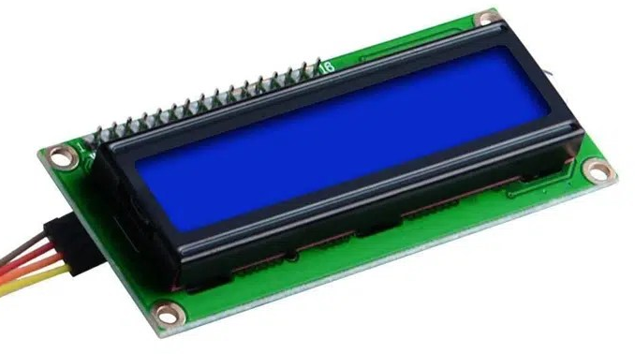
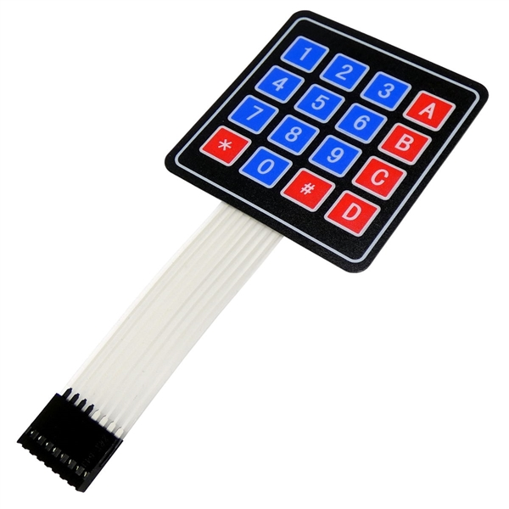
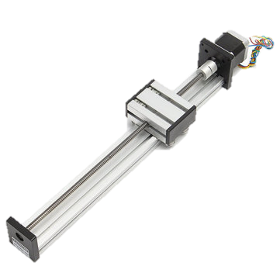
Arduino Session Five
Door Controller Project, potentiometer
Password Protected Gate, keypad

Slide 2
Door Controller Progress
Connected Motor and Encoder
Recorded Rotational Sense Encoder Sequence
Coded Door Setup and Main Control Loop

Slide 3
Door Controller – Variables
Code variables:
Current command (int):
1-> open door
2-> close door
3-> stop motors
Motor ticks (int):
0-> door is closed
200 -> door is fully opened
> 200 -> door needs to be closed

Slide 4
Door Controller – Main Control Loop
If ticks > 210:
Close the door
If ticks in [200, 209] or ticks < 5
User_input = 3

Slide 5
Door Controller – Objectives
Stop motors when the door reaches the limit
Add variable speed for the door using potentiometer
Add Auto Door opening based on PIR sensor

Slide 6
Password Protected Gate – Objectives
Explain how keyboards register keys
Read buttons from keypad and display them on serial monitor
Implement reading password function

Slide 7
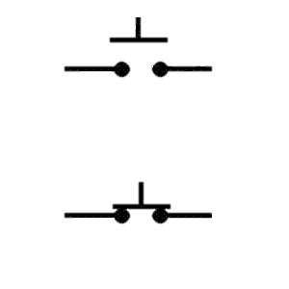
How Pushbutton Works
Current dlow interrupted
Current flow continued

Slide 8
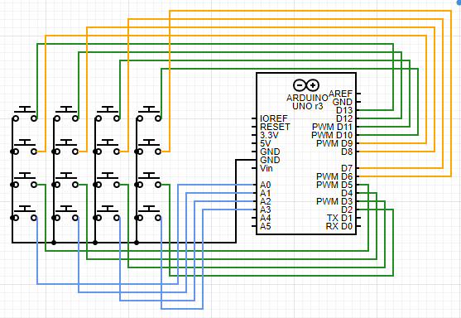
Basis Pushbutton Grid

Slide 9
Active Pushbutton
This button can be enabled return HIGH or LOW based on press
Or Disabled returning always HIGH no matter pressed or not

Slide 10
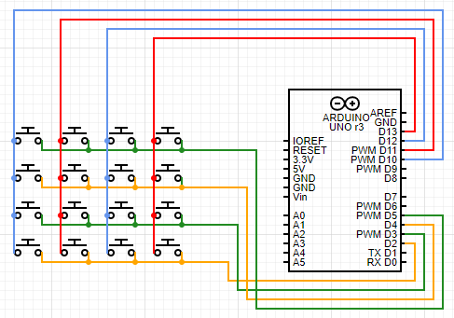
Industrial Pushbutton Grid

Slide 11
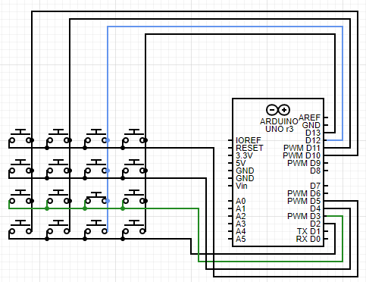
How to Read Keypad

Slide 12
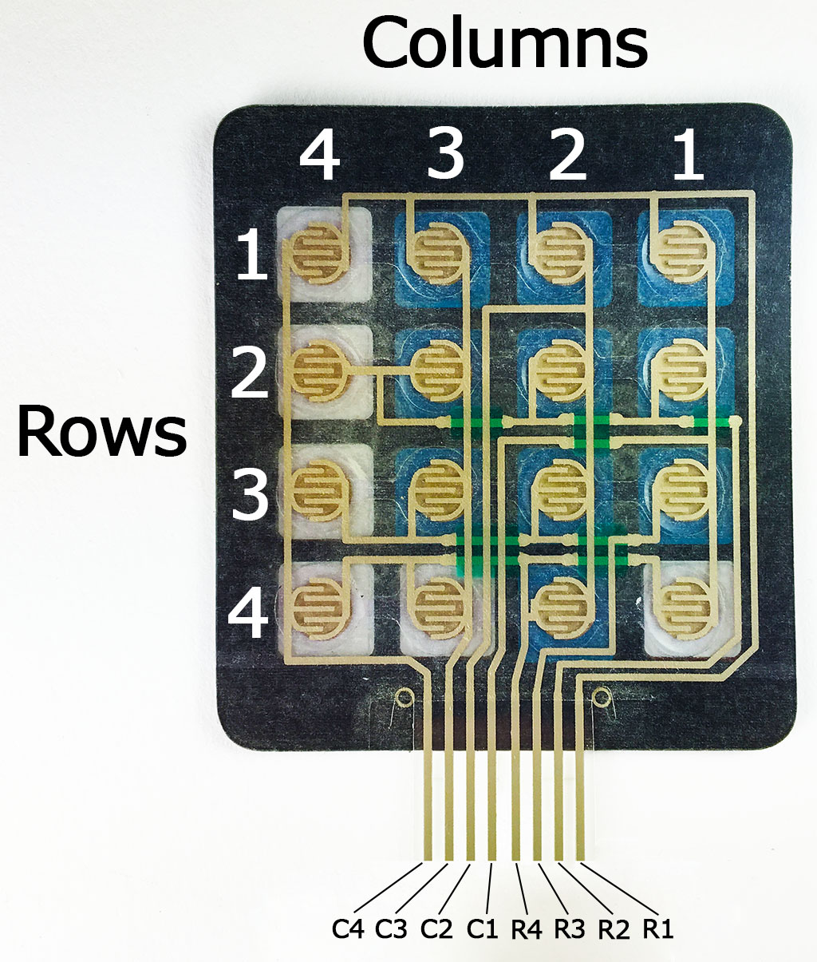
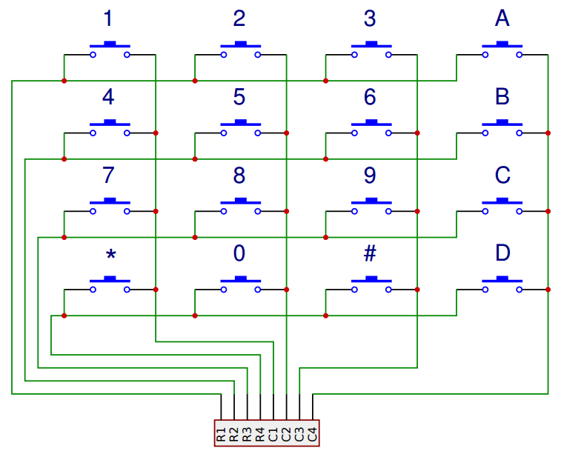
Hobbyist Keypad

Slide 13
Water Tank Meter
Car Parking Assistant
Use Ultrasonic Sensor to determine height of empty tank
Display percentage of remaining water
Close tank filling valve if level is too high, and display filling state (the valve is controlled using servo motor)
Use Ultrasonic Sensor to determine distance from sensor to object
Display the value of lowest distance
Alarm the user if car is too near to an object

Slide 14
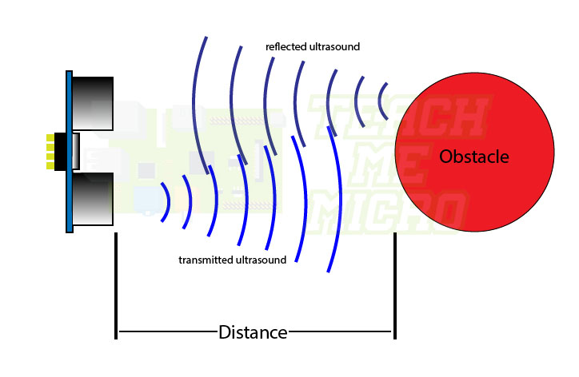
How Ultrasonic works

Slide 15
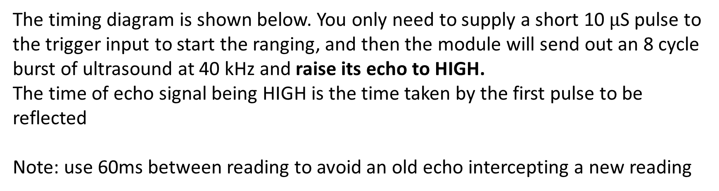
How HC-SR04 Ultrasonic module works
The timing diagram is shown below. You only need to supply a short 10 $μ$S pulse to the trigger input to start the ranging, and then the module will send out an 8 cycle burst of ultrasound at 40 kHz and raise its echo to HIGH.
The time of echo signal being HIGH is the time taken by the first pulse to be reflected
Note: use 60ms between reading to avoid an old echo intercepting a new reading

Slide 16
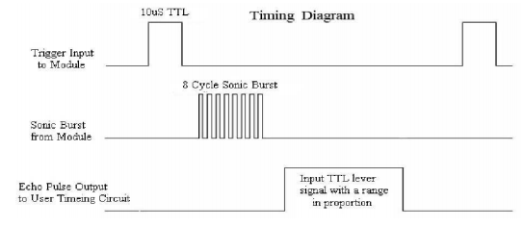
How HC-SR04 Ultrasonic module works

